Slide 1
CSE4255 Lecture 4: Cellular Network

Slide 2
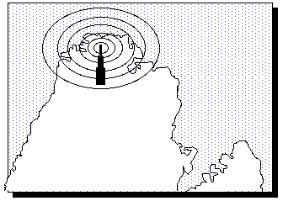
Traditional mobile service was structured in a fashion similar to television broadcasting: One very powerful transmitter located at the highest spot in an area would broadcast in a radius of up to 50 kilometers.
Drawbacks:
High power consumption
Large size of the mobile
Low capacity

Slide 3
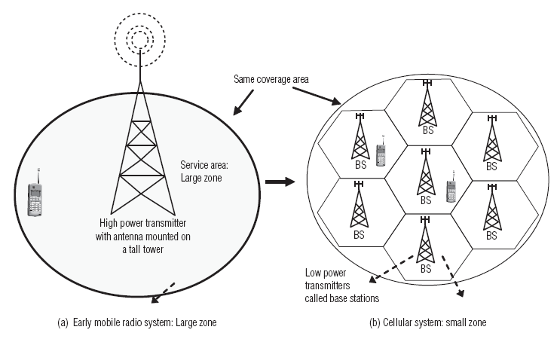
Cellular Concepts:
The Cellular concept is a system level idea which calls for replacing a single high power transmitter with many low power transmitters, each providing coverage to only small portion of the service area.

Slide 4
Features of Cellular Systems:
High capacity – offer very high capacity in a limited spectrum.
Frequency reuse – same frequency in many cell sites.
Cellular expansion – easy to add new cells.
Handover – moving between cells.
Roaming between networks.
Communication is always between mobile and base station (not directly between mobiles).

Slide 5
What is Cell?
A large geographic area is divided into small areas are called cells. Each cell is
served by its own antenna.
allocated a band of frequencies.
The group of cells which collectively use the complete set of available frequencies is called a cluster.

Slide 6
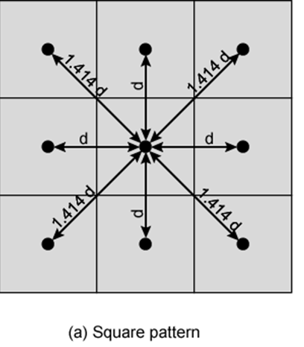
Shape of Cells
Square
The simplest layout to cover an area
This geometry is not ideal
If the width of a square cell is d, then a cell has four neighbors at a distance d and four neighbors at a distance d
Better if all adjacent antennas equidistant
Simplifies choosing and switching to new antenna

Slide 7
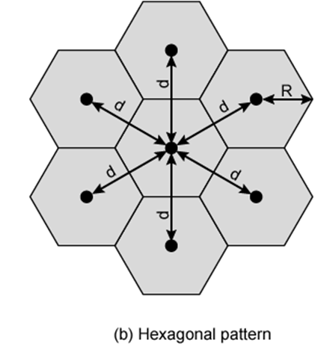
Shape of Cells
Hexagon
Provides equidistant antennas.
Distance from the center to each vertex equals to the length of a side of a hexagon.
For a cell radius R, the distance between the cell center and each adjacent cell center is d =
Cover an entire area without overlapping i.e. cover the entire geographical region without any gaps.

Slide 8
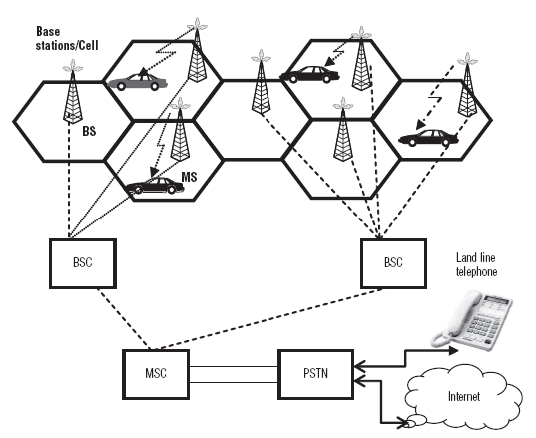
Components of Cellular Systems
1. Mobile station (MS)
2. Base station (BS)
3. Mobile switching centre (MSC)
4. Base station controller (BSC)
5. Public switched telephone network (PSTN)
Figure: Cellular System

Slide 9
Mobile station (MS)
MSs are usually a mobile phone.
Each mobile phone contains a transceiver (transmitter and receiver), an antenna, and control circuitry.
Base station (BS)
It includes antenna, controller, transceivers.
Controller handles call process.
BS provides direct communication with mobile phones and it defines the cell.

Slide 10
Base station controller (BSC)
A number of BSs are connected to a BSC.
It manages the “handoff” from one BS to another as a subscriber moves from cell-to-cell.
A group of BSCs are in turn connected to a MSC via microwave link or telephone lines.
Mobile switching centre (MSC)
One MSC serves multiple BSC
MSC to BSC link by wire or wireless
Connects calls between mobile units and from mobile to fixed telecommunications network
Assigns voice channel to each call
Performs handoffs and monitors the call for billing information

Slide 11
Channels
Each Base station is allocated a portion of total number of channels available to the entire system.
Two types of Channel:
Control channel
Setting up and maintaining calls
Establish relationship between mobile unit and nearest BS.
Traffic channel
Carry voice or data connection between users.

Slide 12
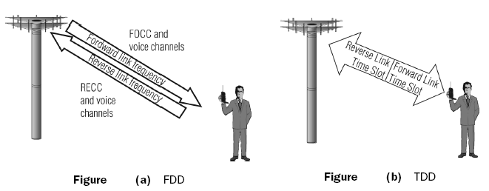
Channels
The duplex concept:
FDD uses two separate frequencies for the uplink (from the mobile to the BS) and the downlink (from the BS to the mobile).
TDD uses a single frequency to transmit signals in both the downlink and uplink directions.
Notes:
For cellular systems, it is necessary to talk or to send data in both directions simultaneously. Using the FDD and
TDD duplexing schemes, simultaneous two-way communication can be established.

Slide 13
Example- 1
If a total of 33 MHz of bandwidth is allocated to a particular FDD cellular telephone system which uses two 25 kHz simplex channels to provide full duplex voice and control channels, compute the number of channels available.
Solution:
Total bandwidth = 33 MHz
Channel bandwidth = 25 kHz x 2 simplex channels
= 50 kHz/duplex channel
Total available channels = 33,000/50 = 660 channels

Slide 14
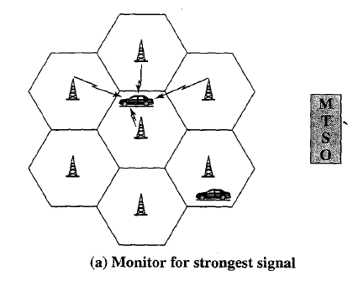
Typical Call in Single MTSO Area (1)
Mobile unit initialization
Scan and select strongest set up control channel.
Automatically selected BS antenna of the cell within which it will operate.
Handshake to identify user and register location.
Scan repeated to allow for movement (Change of cell)
Mobile unit monitors for pages (see later)

Slide 15
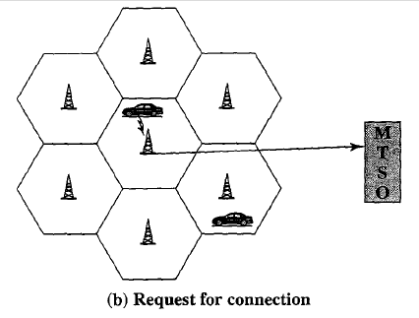
Typical Call in Single MTSO Area (2)
Mobile Originated Call
A mobile unit originates a call by sending the number of the called unit on the preselected setup channels.
First checks the setup channel is idle or not by forward channel.
When idle, transmit on the reverse channel.
The BS sends request to MTSO.

Slide 16
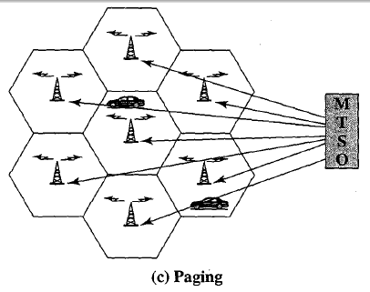
Typical Call in Single MTSO Area (3)
Paging
MTSO attempts to complete the connection to the called unit.
Paging message sent to certain BSs depending on called mobile number.
Each BS transmits the paging signal on set up channel.

Slide 17
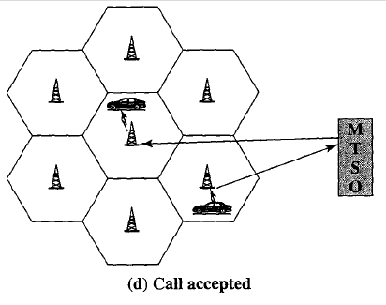
Typical Call in Single MTSO Area (4)
Call Accepted
Mobile unit recognizes number on set up channel.
Responds to BS which sends response to MTSO.
MTSO sets up circuit between calling and called BSs.
MTSO selects available traffic channel within cells and notifies BSs.
BSs notify mobile unit of channel

Slide 18
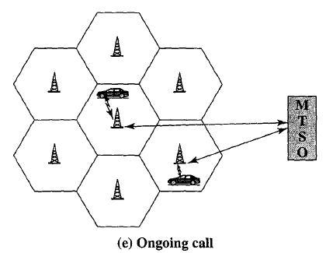
Typical Call in Single MTSO Area (5,6)
Ongoing Call
While the connection is maintained, the two mobile exchange the voice going through their respective BS and MTSO
Handoff
Mobile unit moves out of range of cell into range of another cell
Traffic channel changes to one assigned to new BS without interruption of service to user

Slide 19
Other Functions in an MTSO Controlled Call
Call blocking
If all the traffic channels assigned to the nearest BS are busy
MU makes a preconfigured number of repeated attempts.
After a certain number of failed tries a busy tone is returned to the user.
Call termination
When one of two users hangs up, the MTSO is informed and two BSs are released.
Call Drop
Because of interference and weak signal BS cannot maintain the minimum required signal strength for certain period of time.
Traffic channel to the MU dropped and informed to MTSO
Calls to/from fixed and remote mobile subscriber
MTSO connects to PSTN
MTSO can connect mobile user and fixed subscriber via PSTN
MTSO can connect to remote MTSO via PSTN or via dedicated lines
Can connect mobile user in its area and remote mobile user

Slide 20
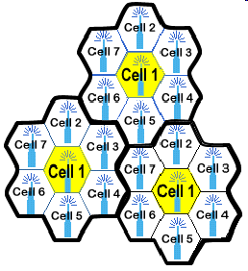
Frequency Reuse
By limiting the coverage area to within the boundaries of a cell, the same group of channels may be used to cover different cells that are separated from one another by distances large enough to keep interference levels within tolerable limits.
The design process of selecting and allocating channel groups for all the cellular base stations within a system is called frequency reuse.
Cells that use the same set of frequency channels are called co-channel cells

Slide 21
Frequency Reuse Concept
Consider cellular system with S duplex channels available, let each cell be allocated a group of k channels (k<s) and if the S channels are divided among N cells.
Available radio channels can be expressed as
S = KN
The N cells which collectively use the complete set of available frequencies is called a cluster.
If it is replicated M times within the system, total no. of duplex channels:
C = MKN = MS
C = Cellular system capacity,
N = Cluster size and typically equal to 4,7,12.

Slide 22
Example- 2
If a total of 33 MHz of bandwidth is allocated to a particular FDD cellular telephone system which uses two 25 kHz simplex channels to provide full duplex voice and control channels, compute the number of channels available per cell if system uses 4 cell reuse.
Solution:
Total bandwidth = 33 MHz
Channel bandwidth = 25 kHz x 2 simplex channels
= 50 kHz/duplex channel
Total available channels, S = 33,000/50 = 660 channels.
Number of cell in a cluster, N = 4.
Number of channel per cell = K
S = KN, K = S/N = 660/4 = 165 channels

Slide 23
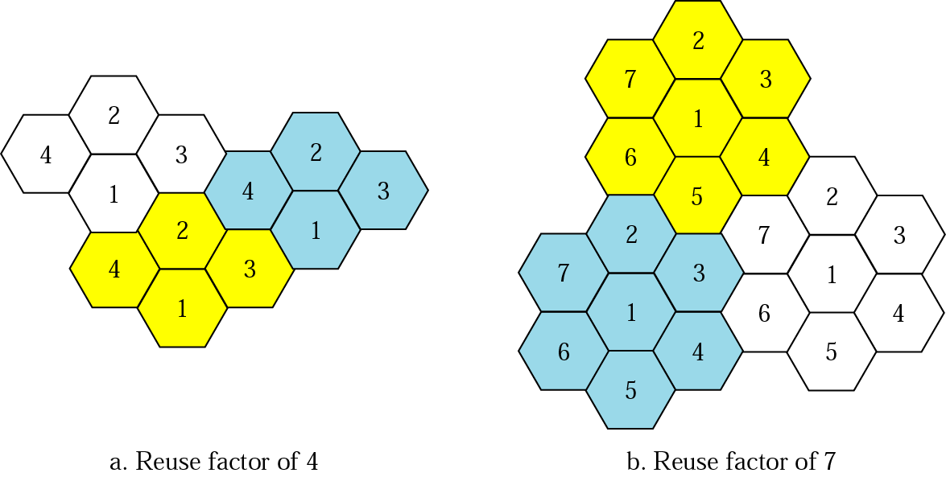
Frequency Reuse Pattern
From geometry of hexagons is such that the number of cells per Cluster, N, can only have the values which satisfy equation
N = i² + ij + j²
i and j are non-negative integers. N can have the values of 3, 4, 7, 9, 12, 13,19,…

Slide 24
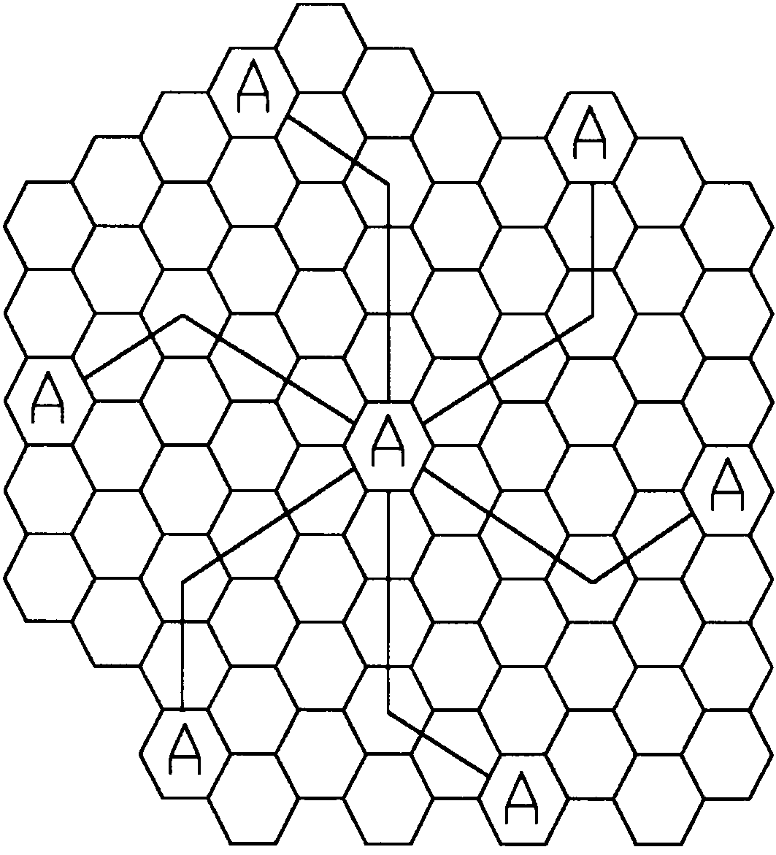
Identify Co-channel Cell
To find the nearest co-
channel of a neighboring
cell:
Move i cells along any chain of hexagons.
Turn 60 degrees counter clockwise.
Move j cell.
Figure: Method of locating co-channel cells in a cellular system. In this example, N = 19 (i.e., i = 3, j = 2).
Notes:
Fig. 3.2

Slide 25
Channel Assignment Strategies
Channel assignment affects the performance of the system, especially when it comes to handoffs.
There are several channel assignment strategies. We will discuss two basic types:
Fixed Channel Assignment
Dynamic Channel Assignment

Slide 26
1. Fixed Channel Assignment
In this channel assignment, each cell is allocated a predetermined set of voice channels. Such a channel assignment has the following aspects:
Any call attempt within the cell can only be served by the unused channels in that particular cell.
If all the channels in that cell are occupied, the call is blocked and the subscriber does not receive service.
A variation of this method is the Borrowing Strategy:
Cells in this strategy are allowed to borrow channels from adjacent cells if their channels are fully occupied while adjacent cells have free channels,
MSC (Mobile Switching Center) monitors the process and gives permission to borrowing cell to borrow channels putting in mind (i) donating cell is not affected by the borrowing process, (ii) no interference will occur by moving the channel from one cell to another.

Slide 27
2. Dynamic Channel Assignment
In this channel assignment, channels are not pre‐allocated to any cells meaning that any channel can be allocated to any desired cell during the operation of the system. Such a channel assignment has the following aspects:
MSC monitors all cells and all channels,
Each time a call request is made, serving BS requests a channel from the MSC,
MSC runs an algorithm that takes into account:
Possibility of future blocking in cells
Frequency being used for channel
The reuse distance of the channel
MSC assigns a channel only if it is not used and if it will not cause co‐channel interference with any cell in range,
This algorithm provides higher capacity (less blocking), it requires huge computational power,

Slide 28
Problem 1:
Assume a system of 32 cells with a cell radius of 1.6 km, a total frequency bandwidth that supports 336 traffic channels, and a reuse factor of N = 7.
What geographic area is covered by the system?
How many channels are there per cell?
What is the capacity of the system?
Repeat for a cell radius of 0.8 km and 128 cells.
Notes:
Ans: Stalling Example 10.1

Slide 29
Problem 2:
If a total of 33 MHz of bandwidth is allocated to a particular FDD cellular system, which uses two 25 KHz simplex channels to provide full duplex voice and control channels.
Compute the number of channels available per cell if system uses 4 cell reuse.
Assume that 1 MHz is dedicated to control channels but that only one control channel is needed per cell. Determine a reasonable distribution of control channels and voice channels in each cell.
Repeat the (a) and (b) for 7 reuse factor.
Notes:
Ans: Rappaport Example 3.1

